Slide 1
Data Visualization
With Python
June 14, 2018

Slide 2
Course Outline
https://www.datacamp.com/courses/introduction-to-data-visualization-with-python
Python tools
Matplotlib
Seaborn
Exercises
Plotting skills: common axes, axes in figure, subplots
Customization of plots
Regressions / residuals / grouping
Distributions: strip, swarm and violin plots
Bonus
2D plots
Turtle

Slide 3
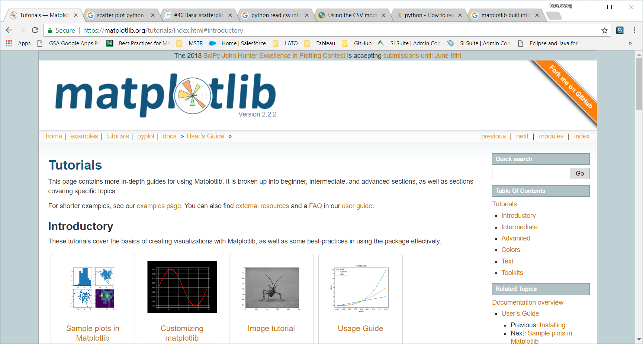
https://matplotlib.org/tutorials/index.html#introductory
https://matplotlib.org/users/customizing.html
https://tonysyu.github.io/raw_content/matplotlib-style-gallery/gallery.html

Slide 4
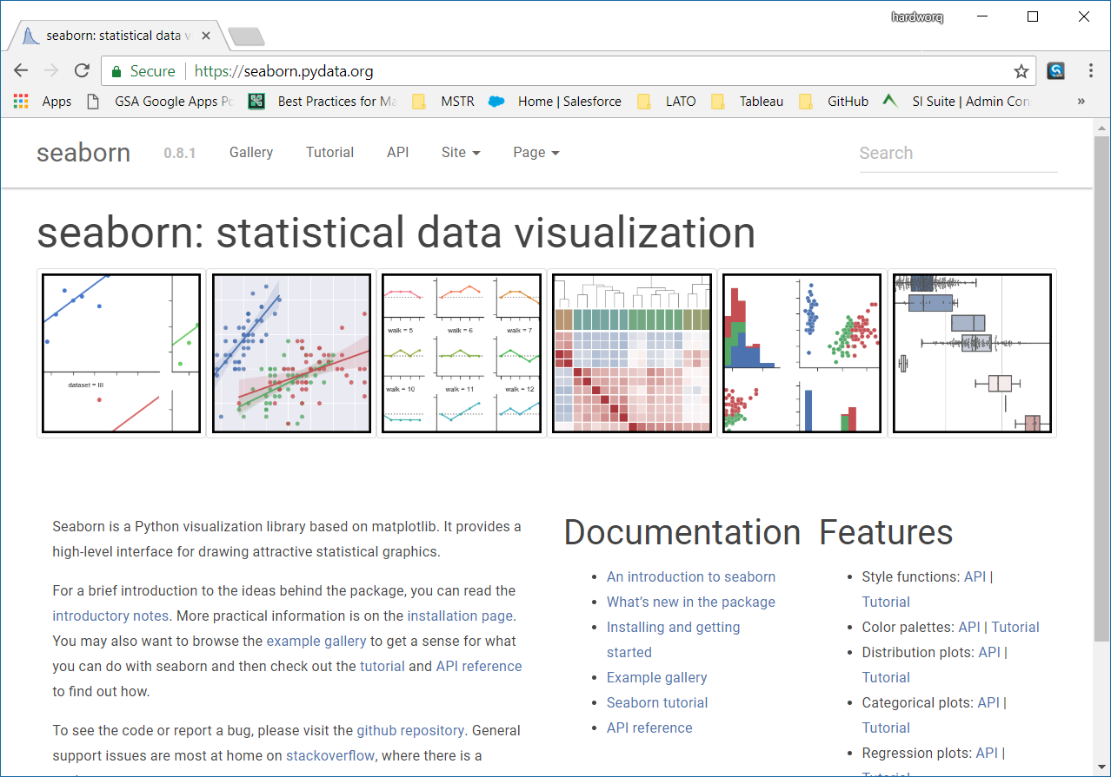
https://seaborn.pydata.org/

Slide 5
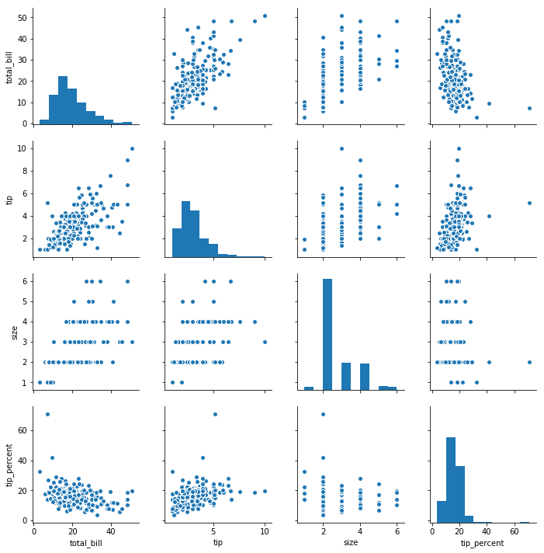
Copy / save plot image w/ right click

Slide 6
Customizing plots

Slide 7
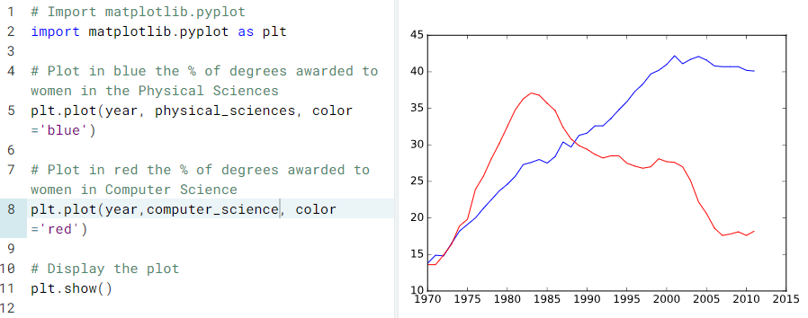
Multiple plots on single axis

Slide 8
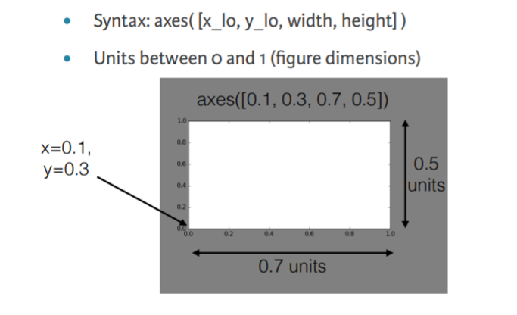
axes() command

Slide 9
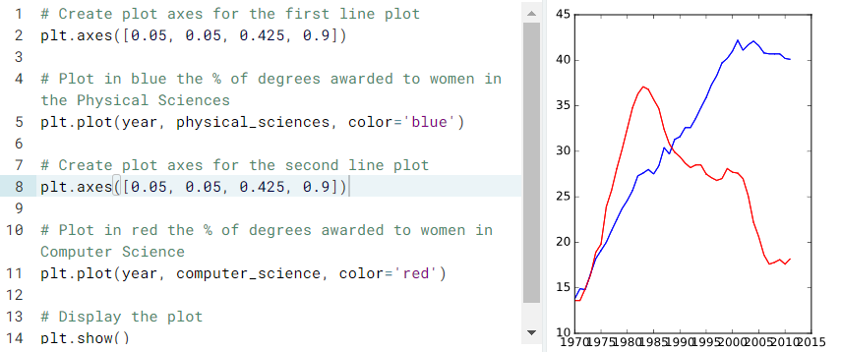
Using axes()

Slide 10
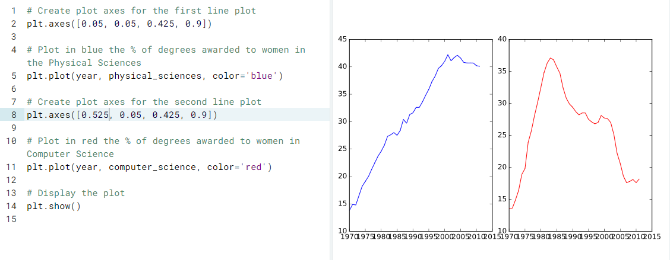
Using axes() (2)

Slide 11
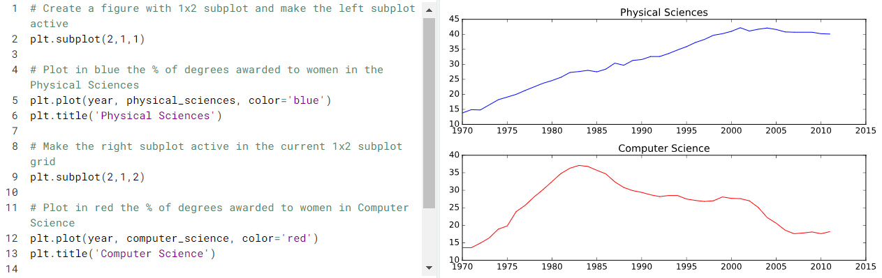
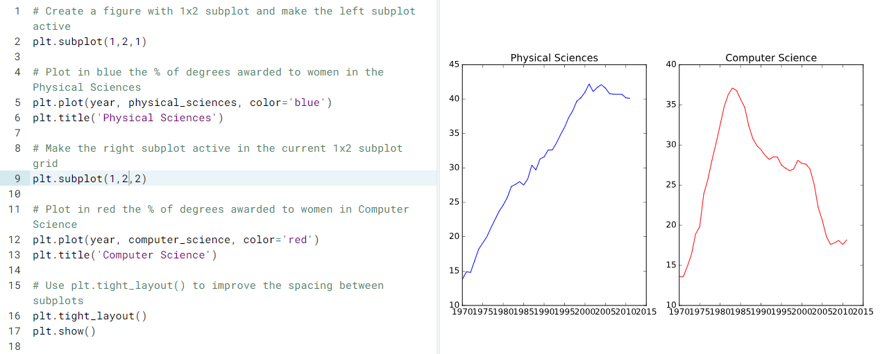
Using subplot() (1)

Slide 12
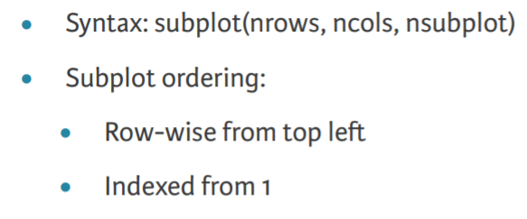
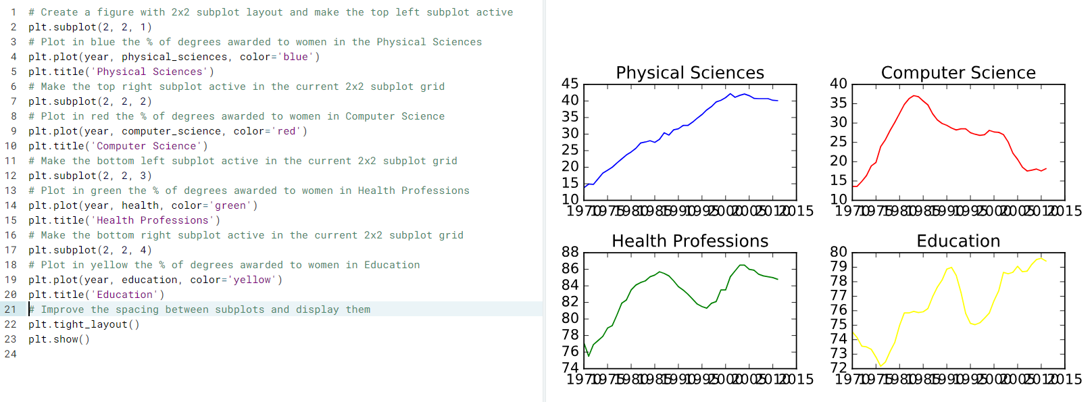
Using subplot() (2)

Slide 13
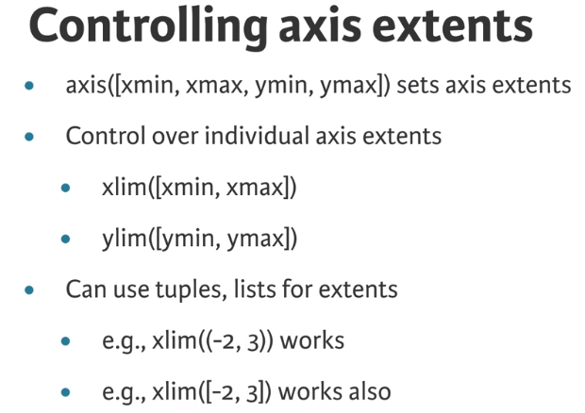
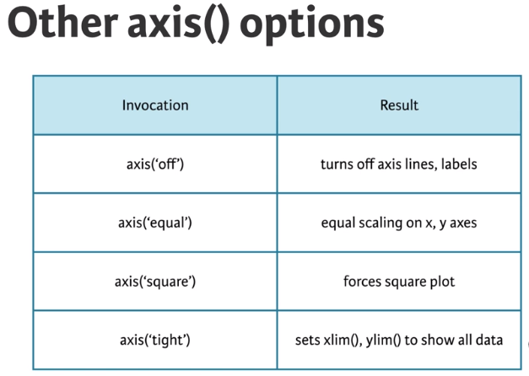
Customizing axes

Slide 14
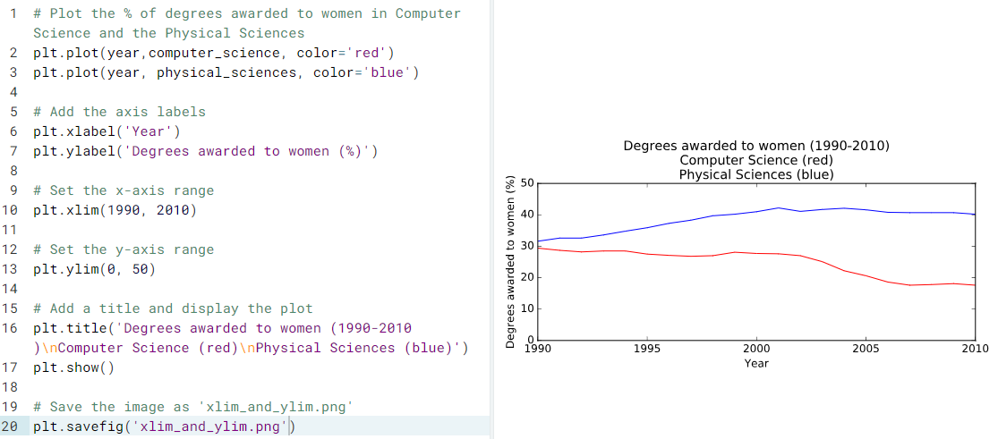
Using xlim(), ylim()

Slide 15
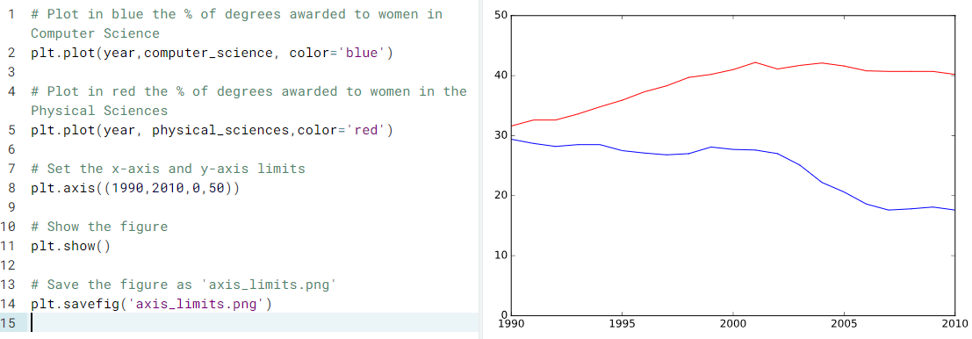
Use plt.axis()

Slide 16
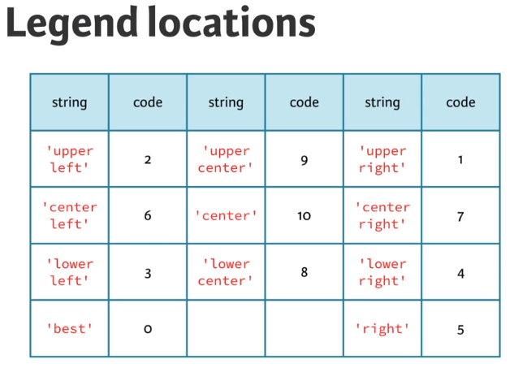
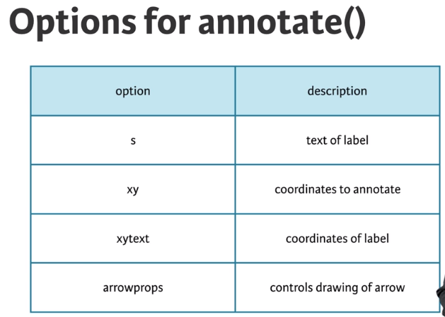
Legend

Slide 17
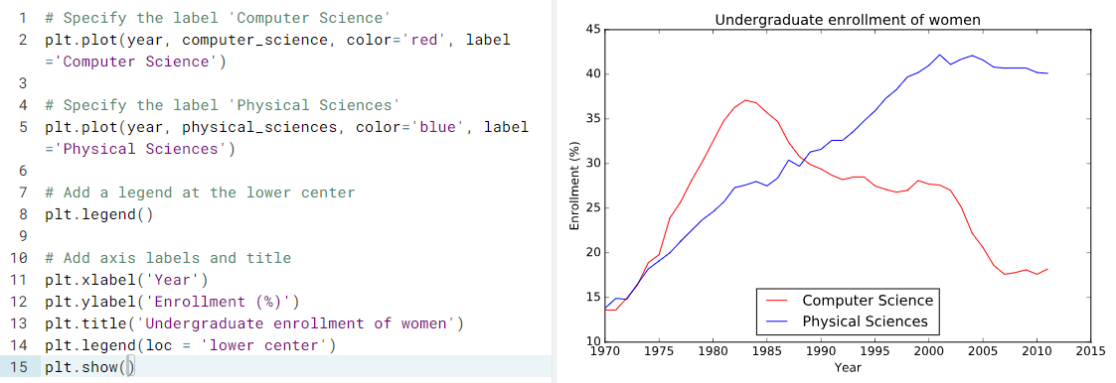
Legend (Cont. 2)

Slide 18
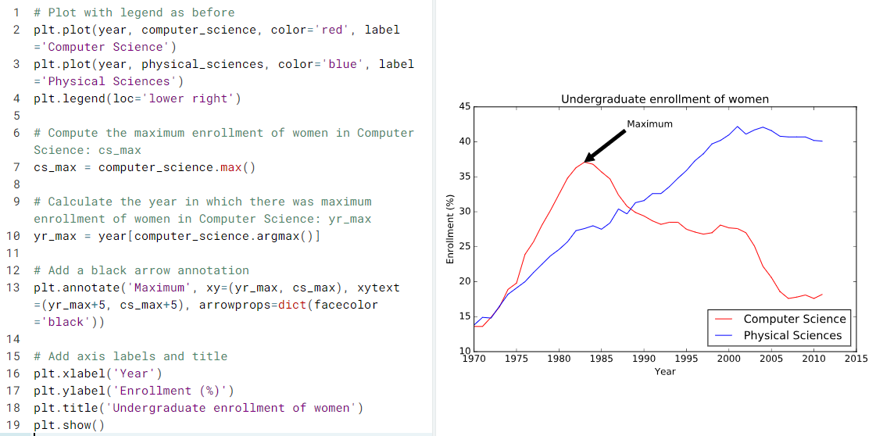
Using annotate()

Slide 19
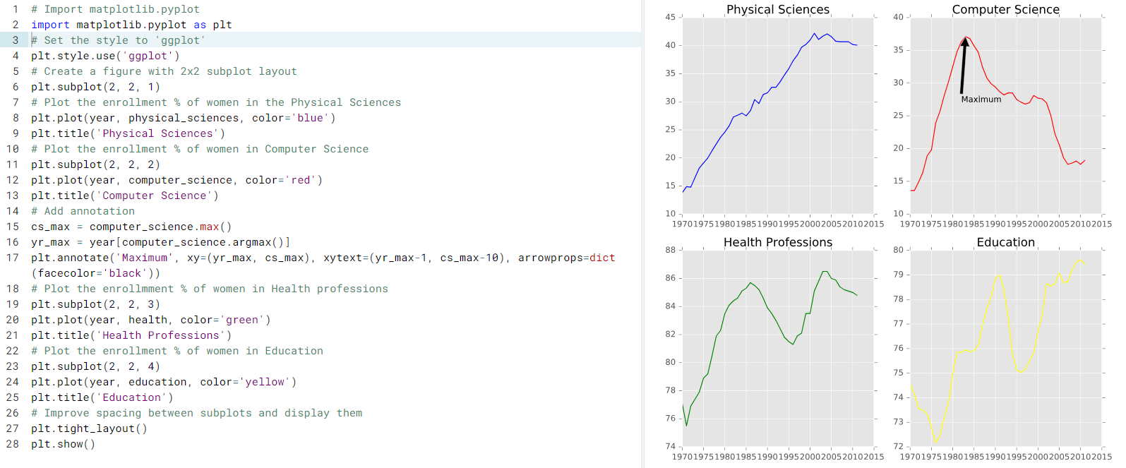
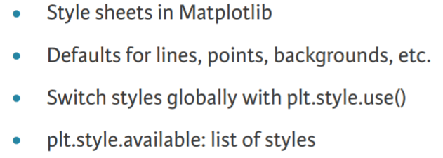
Modifying styles

Slide 20
Statistical Plotting

Slide 21
Seaborn
Built on top of Matplotlib
Purpose: simplify visualizing statistical data
Works with Pandas – data frame package

Slide 22
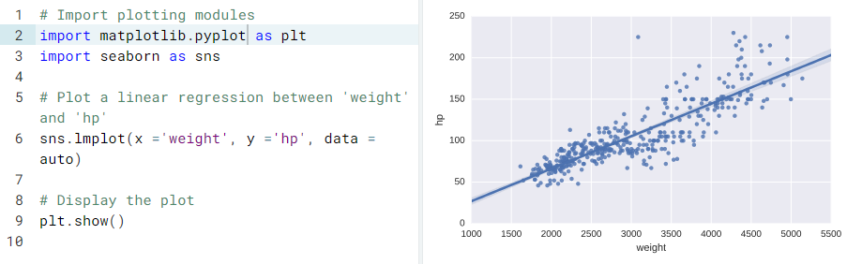
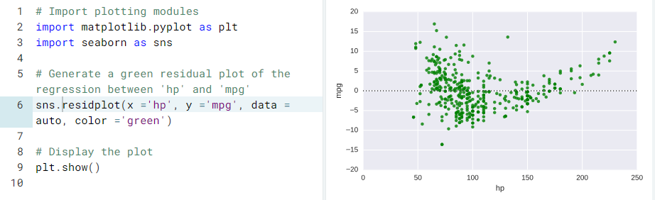
Simple linear regressions and residuals

Slide 23
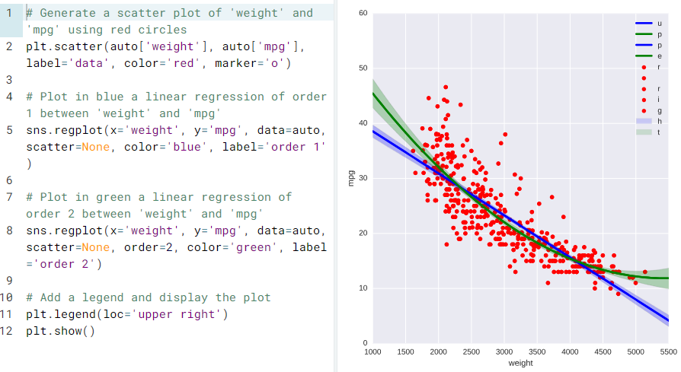
Higher-order regressions

Slide 24
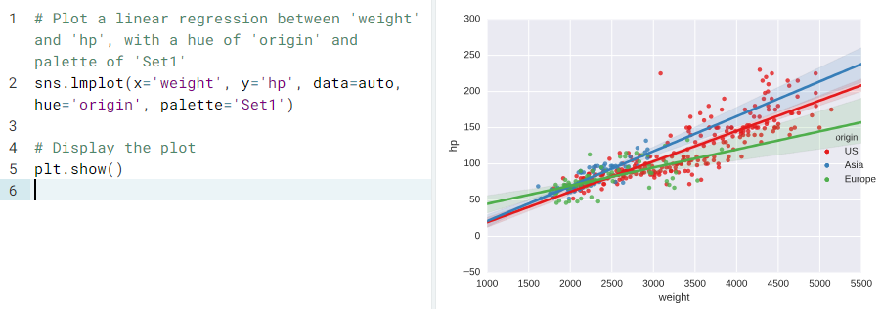
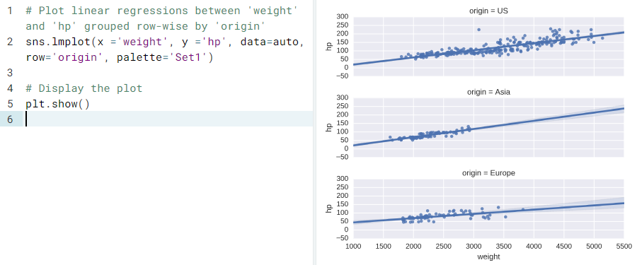
Grouping linear regressions
by hue
by row / column

Slide 25
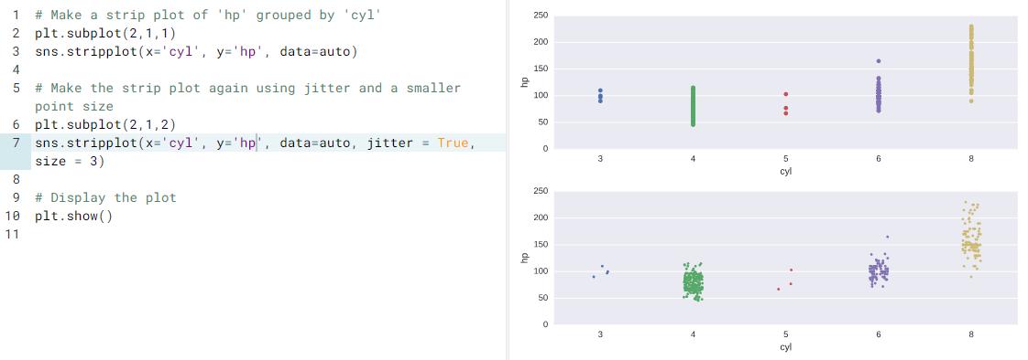
Constructing strip plots

Slide 26
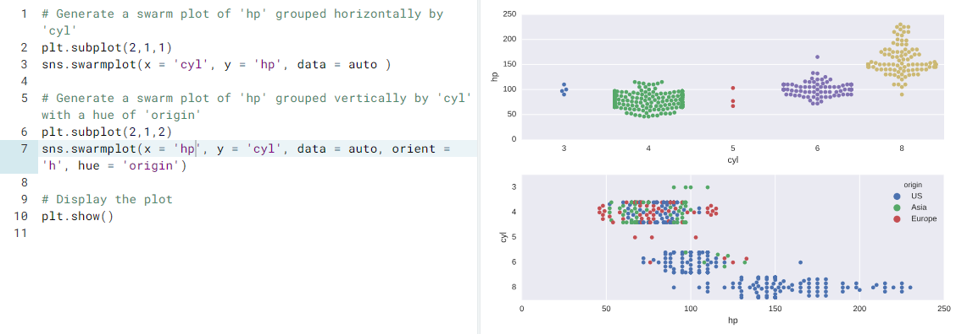
Constructing swarm plots

Slide 27
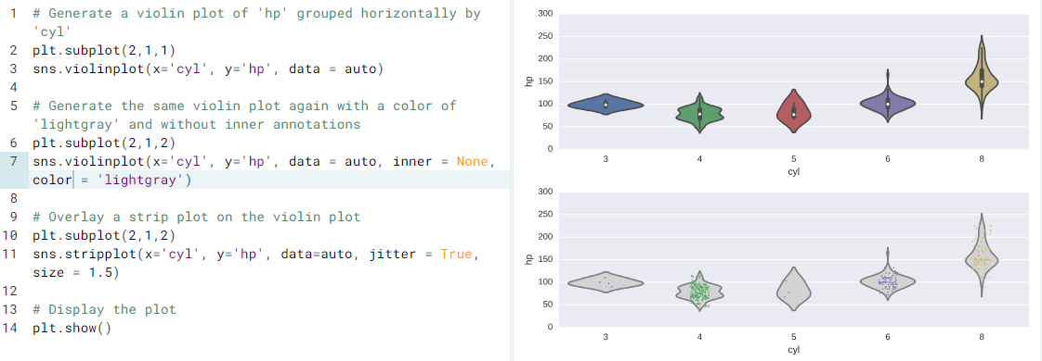
Constructing violin plots

Slide 28
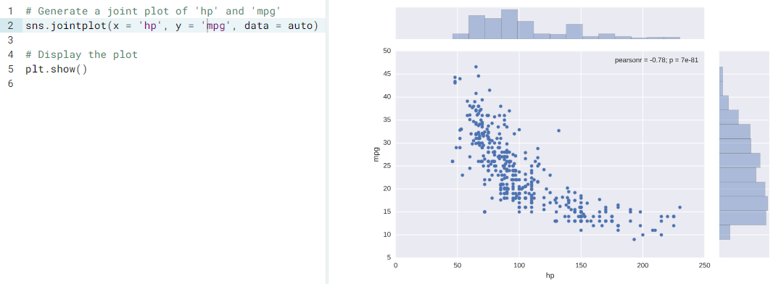
Plotting joint distributions (1)

Slide 29
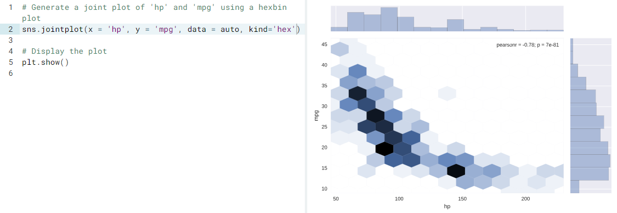
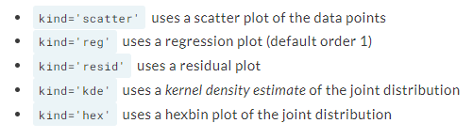
Plotting joint distributions (2)

Slide 30
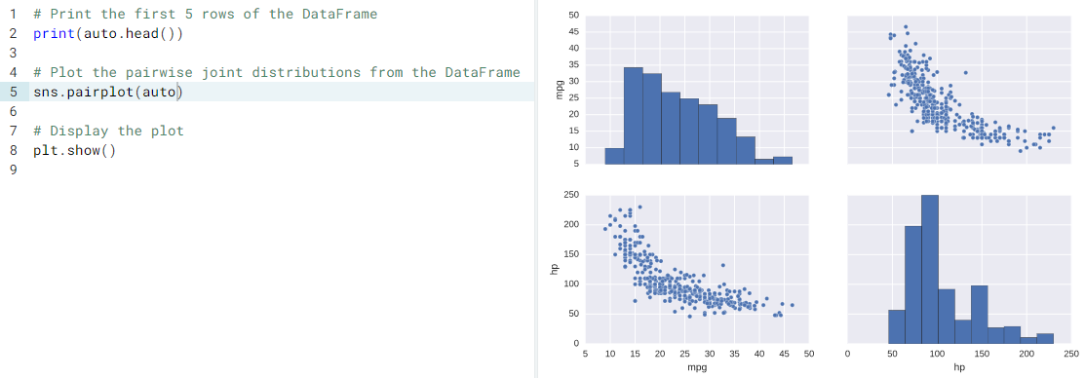
Plotting distributions pairwise (1)

Slide 31
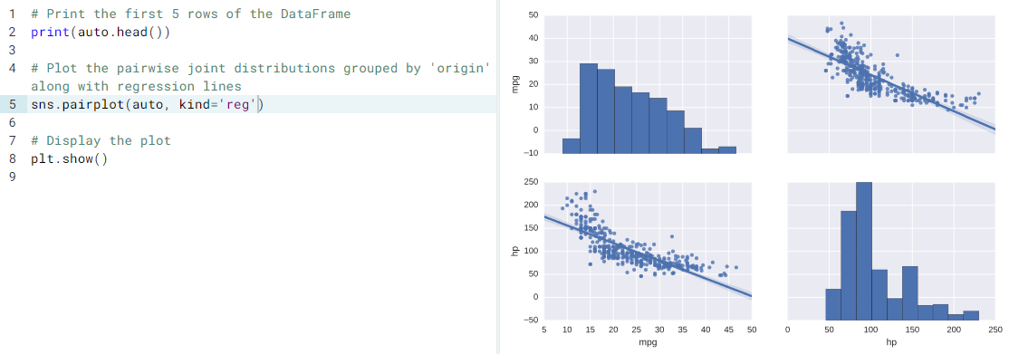
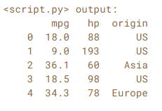
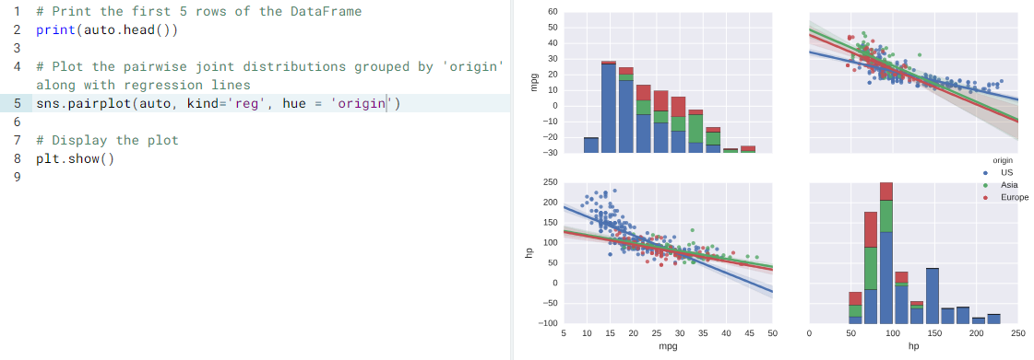
Plotting distributions pairwise (2)

Slide 32
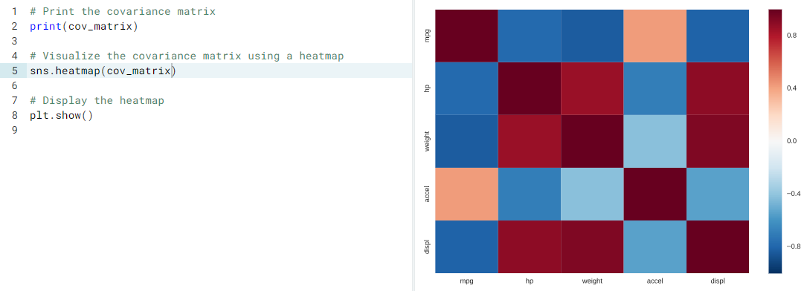
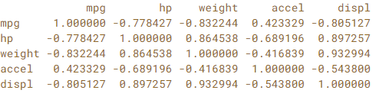
Visualizing correlations with a heatmap

Slide 33
Plotting 2D arrays

Slide 34
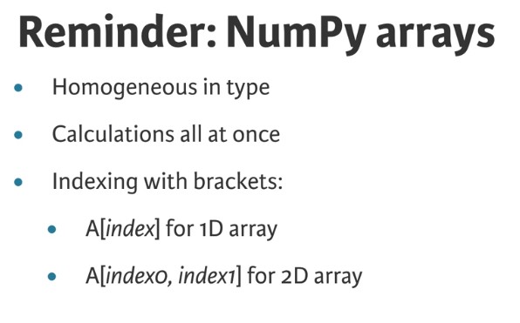
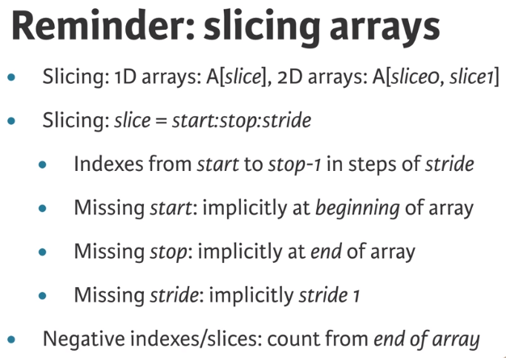

Slide 35
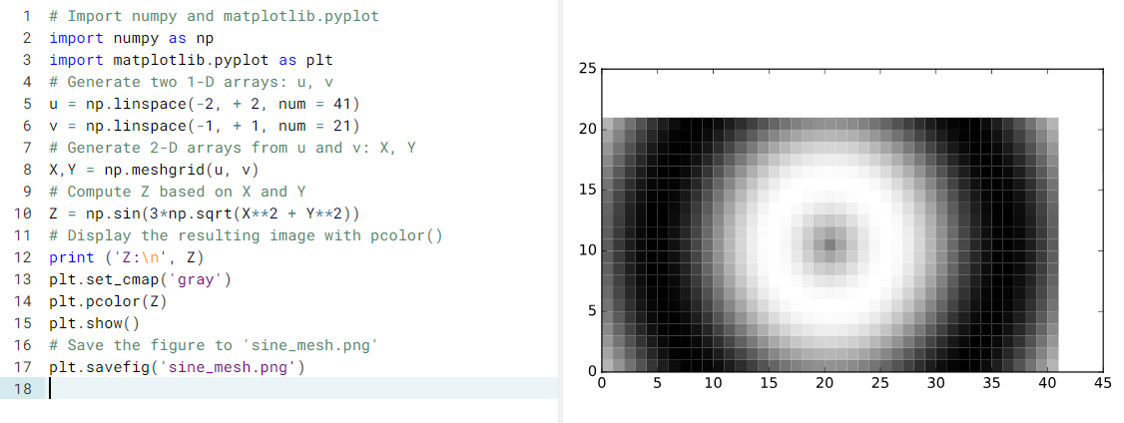
Generating meshes

Slide 36
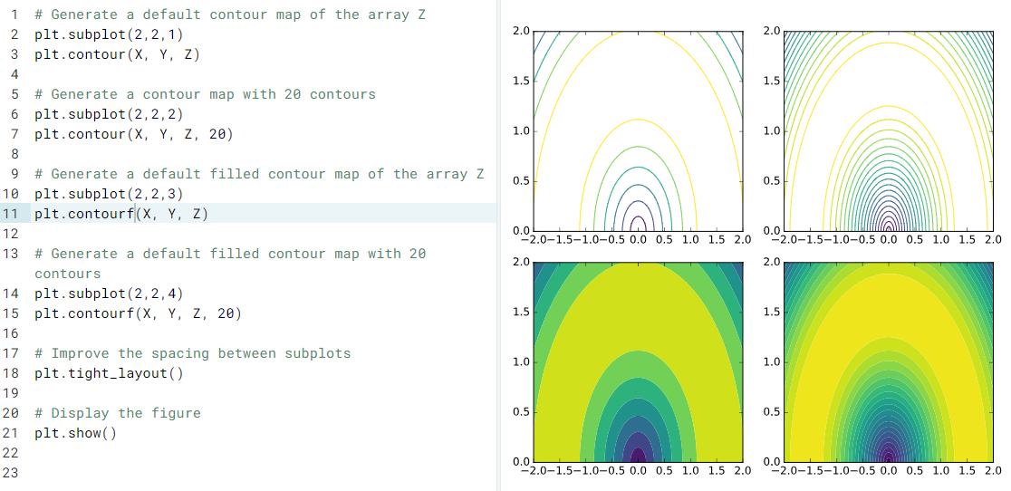
Contour & filled contour plots

Slide 37
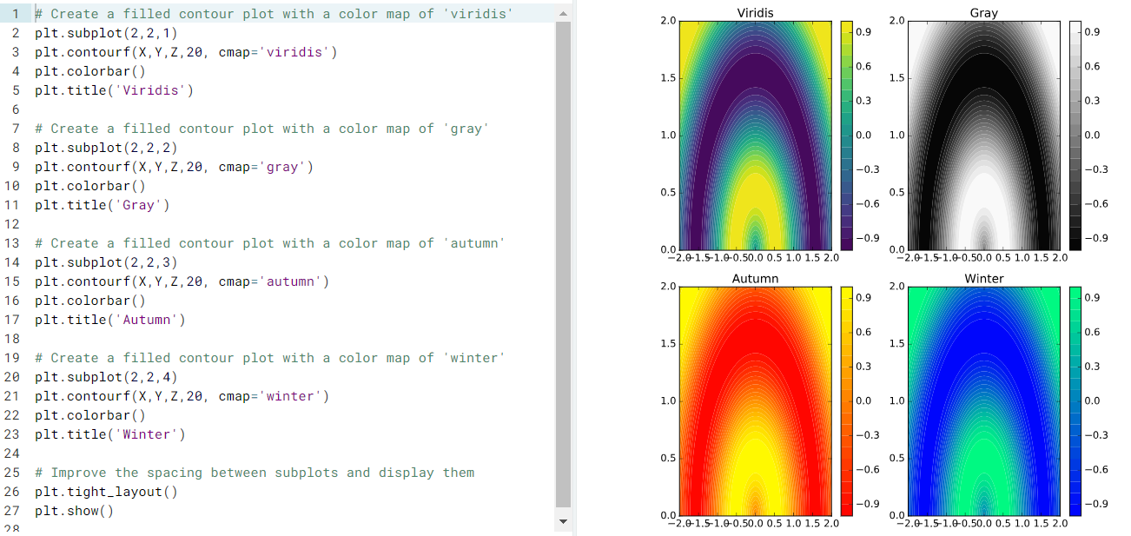
Modifying colormaps

Slide 38
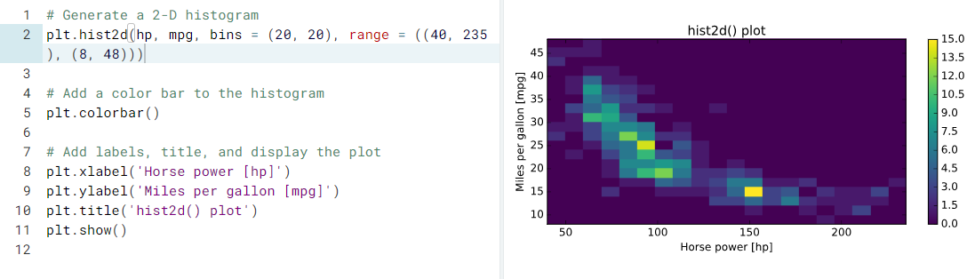
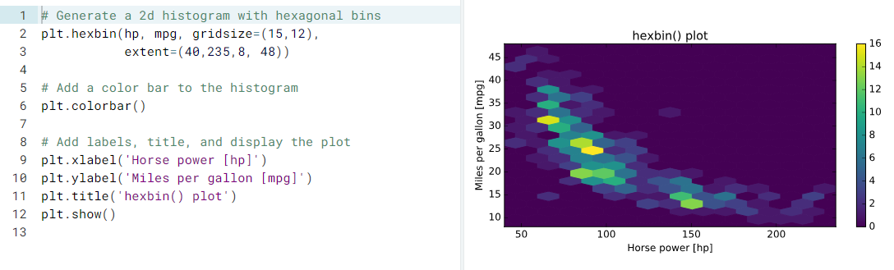
Using hist2d() and hexbin()

Slide 39
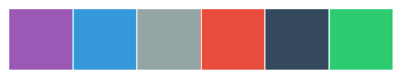


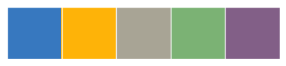
Seaborn color palettes
https://seaborn.pydata.org/tutorial/color_palettes.html
Qualitative (categorical) palettes
Sequential palettes
Diverging palettes
http://colorbrewer2.org/#type=sequential&scheme=BuGn&n=3
Provide guidance for color blind safe design
XKCD colors

Slide 40
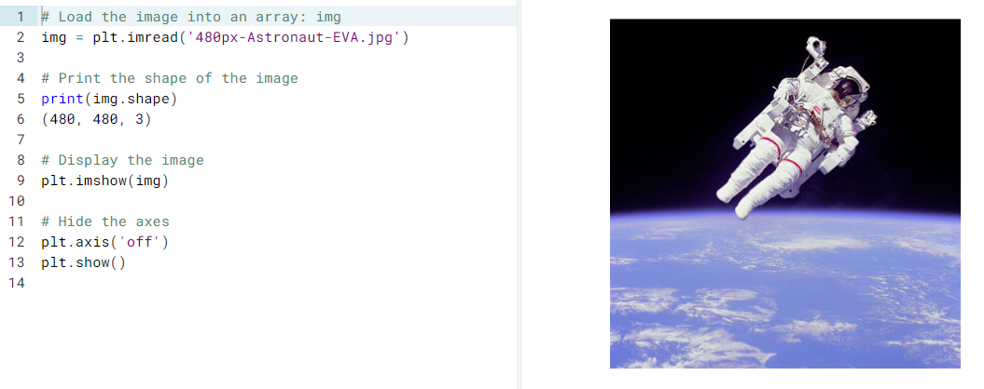
Loading, examining images

Slide 41
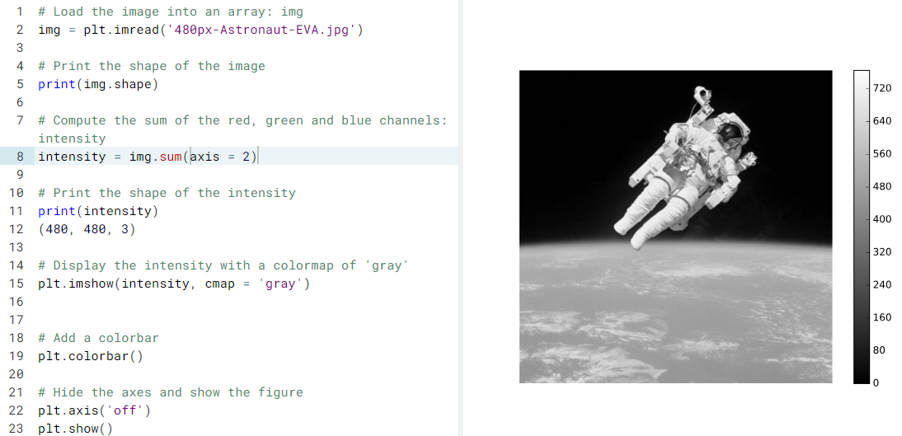
Pseudocolor plot from image data

Slide 42
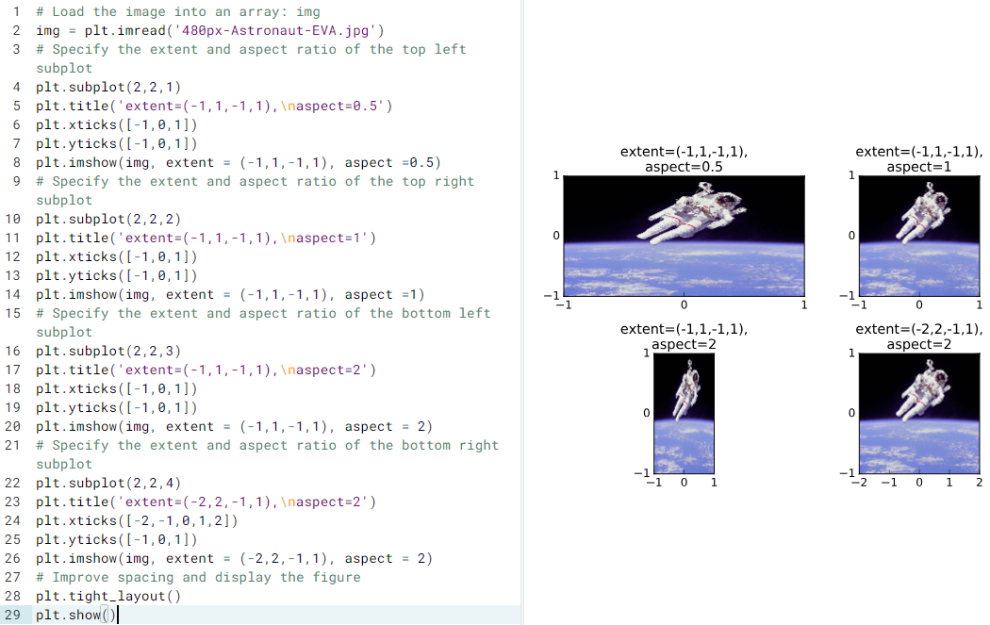
Extent and aspect

Slide 43

Rescaling pixel intensities

Slide 44
Turtle https://docs.python.org/2/library/turtle.html http://www.cs.middlebury.edu/~mlinderman/courses/middsip/sm17/lectures/lecture4-notes.html
Turtle graphics is a popular way for introducing programming to kids
It was part of the original Logo programming language developed by Wally Feurzig and Seymour Papert in 1966
Imagine a robotic turtle starting at (0, 0) in the x-y plane
Give it the command turtle.forward(15), and it moves (on-screen!) 15 pixels in the direction it is facing, drawing a line as it moves
Give it the command turtle.right(25), and it rotates in-place 25 degrees clockwise.
By combining together these and similar commands, intricate shapes and pictures can easily be drawn.

Slide 45


Mathematical drawing with Turtle

Slide 46
Q & A

